Slide 2
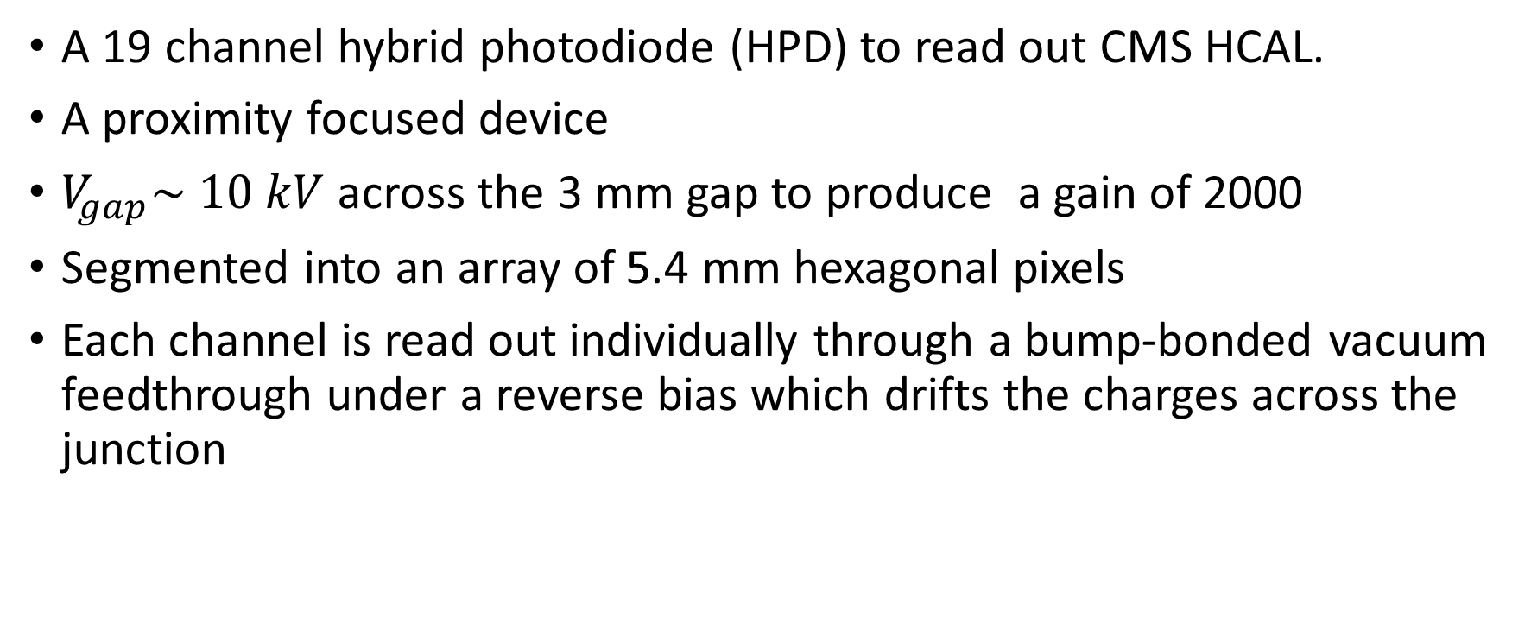
Introduction
A 19 channel hybrid photodiode (HPD) to read out CMS HCAL.
A proximity focused device
$V_{gap}\sim 10 kV$ across the 3 mm gap to produce a gain of 2000
Segmented into an array of 5.4 mm hexagonal pixels
Each channel is read out individually through a bump-bonded vacuum feedthrough under a reverse bias which drifts the charges across the junction

Slide 3
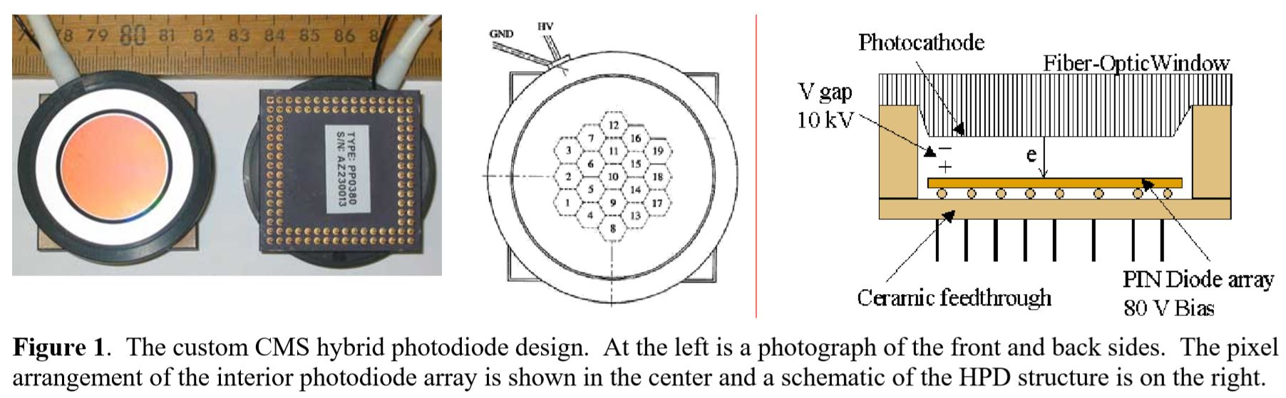
Expected life 10 years, integrated charge of 3 C/pixel at the highest pseudo-rapidity locations.
Extended lifetime tests
Evaluate the long term stability of the tubes under high voltage
Measure any degradation in response over time and integrated charge.
Accelerated tests are used to reproduce the total integrated charge
Lower intensity tests evaluate the rate of change expected in normal CMS running.

Slide 4
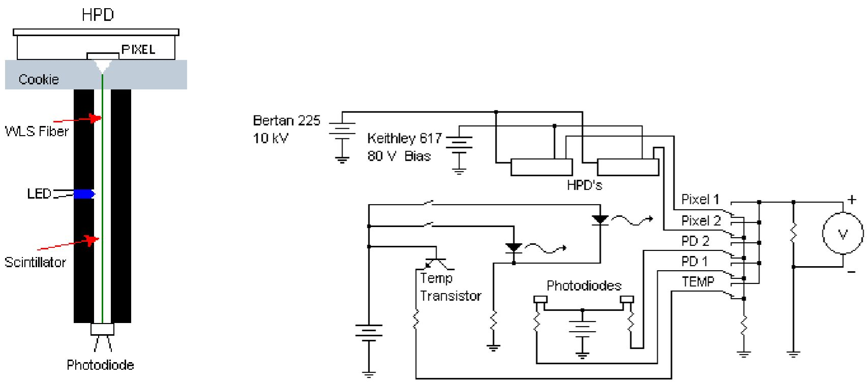
Lifetime tests under illumination
10 cm,
Scintillator Stick
Dia = 1 mm
WLS

Slide 5
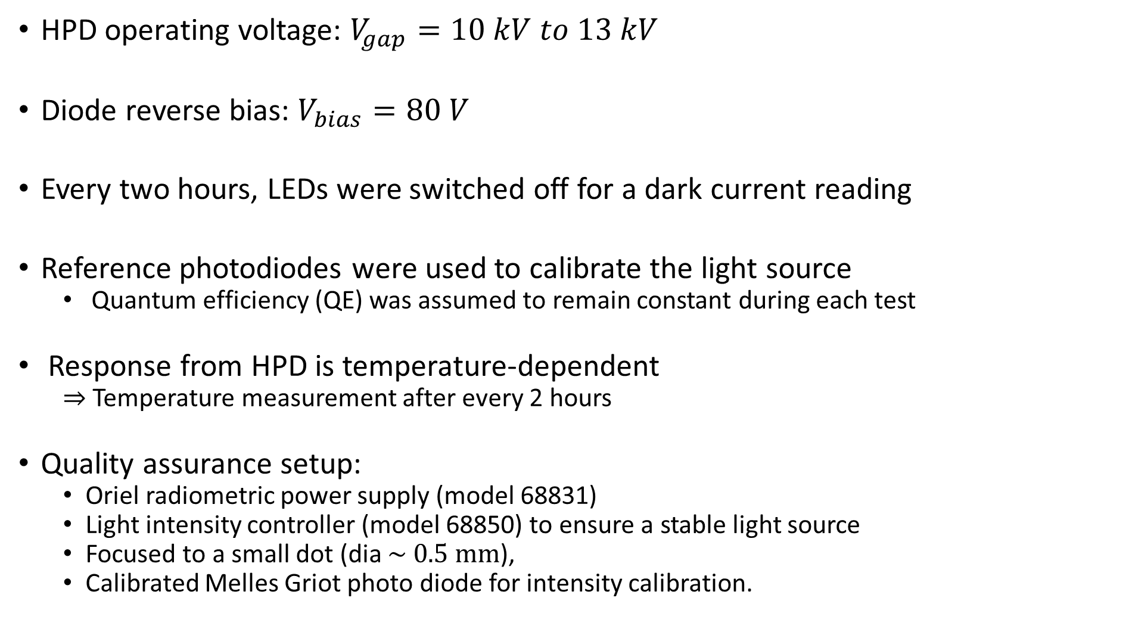
HPD operating voltage: $V_{gap}=10 kV to 13 kV$
Diode reverse bias: $V_{bias}=80 V$
Every two hours, LEDs were switched off for a dark current reading
Reference photodiodes were used to calibrate the light source
Quantum efficiency (QE) was assumed to remain constant during each test
Response from HPD is temperature-dependent
$⇒$ Temperature measurement after every 2 hours
Quality assurance setup:
Oriel radiometric power supply (model 68831)
Light intensity controller (model 68850) to ensure a stable light source
Focused to a small dot (dia $\sim 0.5 mm$),
Calibrated Melles Griot photo diode for intensity calibration.

Slide 6
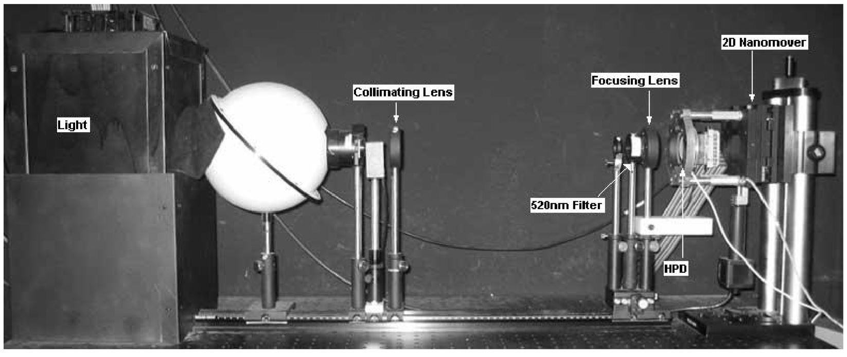

Area Scan:
Two-dimensional nanomover (step size = 0.5mm)
Dark and light response from all
Pixel response: Averaged over $1 mm^{2}$.

Slide 7
Time-dependent Pixel Response
Test 1(a):
Pixels 9 and 11 from HPD-1 were illuminated
Pixel 9 anode current 12.1 C/yr. Very bright, Accelerated aging test
Pixel 11 at 1.48 C/yr one-tenth of the rate
CMS after 10 years, expected integrated charge into any one pixel at the worst locations: 3C
Pixel 9: 40 times the CMS exposure rate
Pixel 11: 4 times
Test 1(b):
HPD-1 removed after continuous operation of 8 months and stored in dark for 7 months.
Then, operated for 6 months with same pixels (Test 1b)
Then light was turned off for 2 months, with HPD left at bias and high voltage
Test 1 ends and HPD was stored for 3 months

Slide 8
Second Test
HPD-2: Pixel 10 at 1.35 C/yr
HPD-1: Pixel 3 at 9.15 C/yr (Pixel 9 and 11: damaged from test 1)
Why pixel 3: To look for any shifting in the damage profiles both near (11) and far (9) from the illumination point, as well as for signs of photocathode recovery.
Test run: 7 months

Slide 9
Observations
Notations:
Absolute light intensity in nW – measured by a calibrated HPD
Signal - Initial pixel signal from HPD-1 or HPD-2
C/year – Defined using signal readings
Integrated charge: Actual measurement of the charge passing through the HPD over time.
Thus includes the degradation in response of the tube

Slide 10
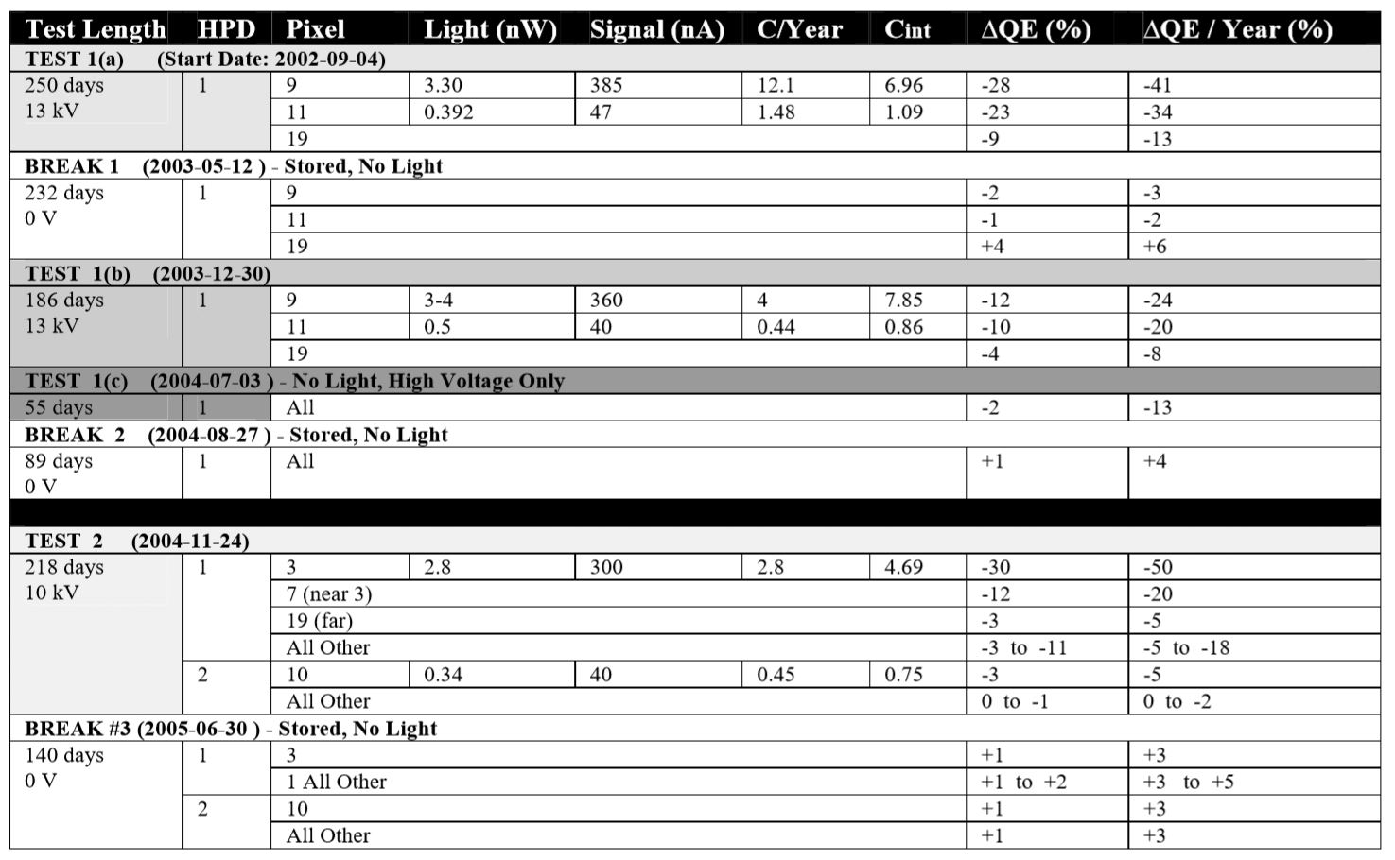

Slide 11
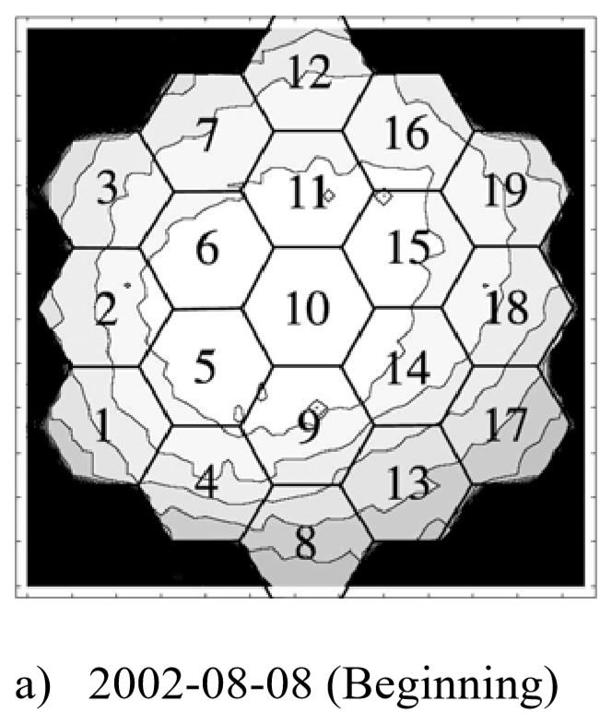
Progress of localized damage under bright illumination
Initial Scan
HPD is locally uniform with a gradual 20 % fall off toward the edges (within CMS specification)

Slide 12
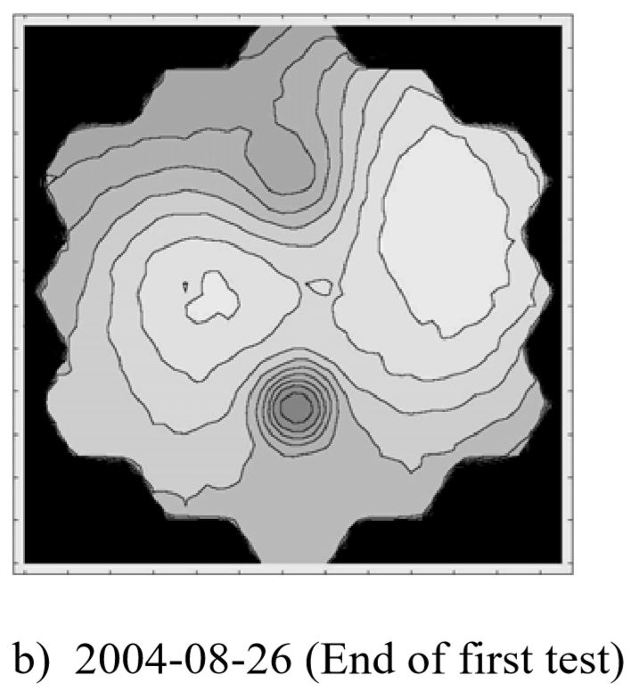
End of test 1:
Equivalent to 33 years of CMS running into one pixel
Damage to illuminated pixels 9 (bright) and 11 (dim) are clearly visible.
Damage is local to the pixel
Degradation in the outer edges closest to the illuminated pixels and in the region bridging the two pixels.

Slide 13
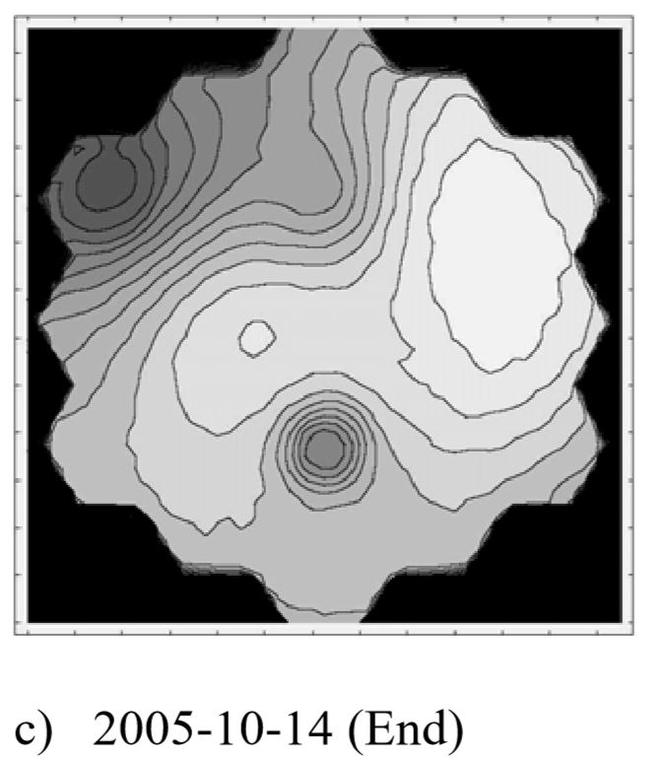
End of Test 2:
Damaged region extends to neighboring pixels
Previously damaged regions further away maintain the same damage pattern, while slowly degrading as a whole.

Slide 14
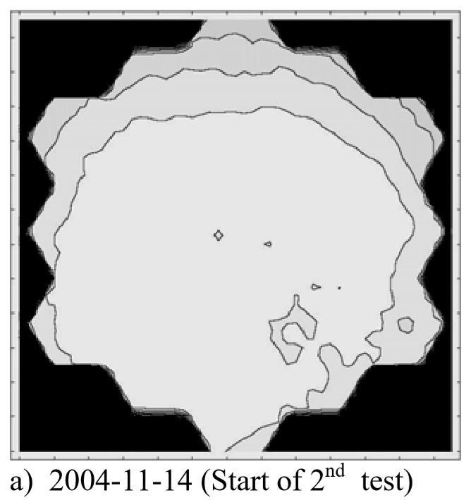
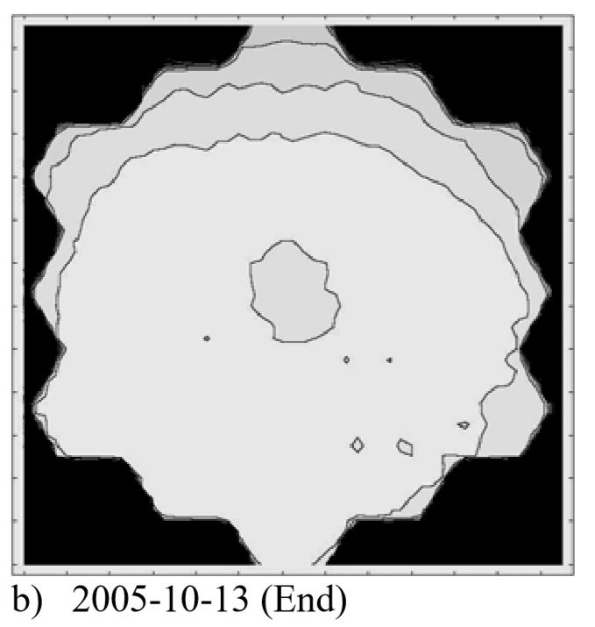
Area scan of HPD-2:
Only 3% reduction in calibrated response, for a much less aggressive illumination rate of 1.35 C/year
(still more than 4 times that expected at the
worst CMS location)
None of the non-illuminated pixels were affected significantly by illumination of pixel 10 at the lower rate.

Slide 15
The progress of selected pixels as a function of time, using data from the periodic area scans
Curves are normalized to the first data point for each pixel
Change in an illuminated pixel is relative to a “control” pixel which was not illuminated during the test
The total tube response degrades monotonically during illumination and then recovers slightly during dark storage.

Slide 16
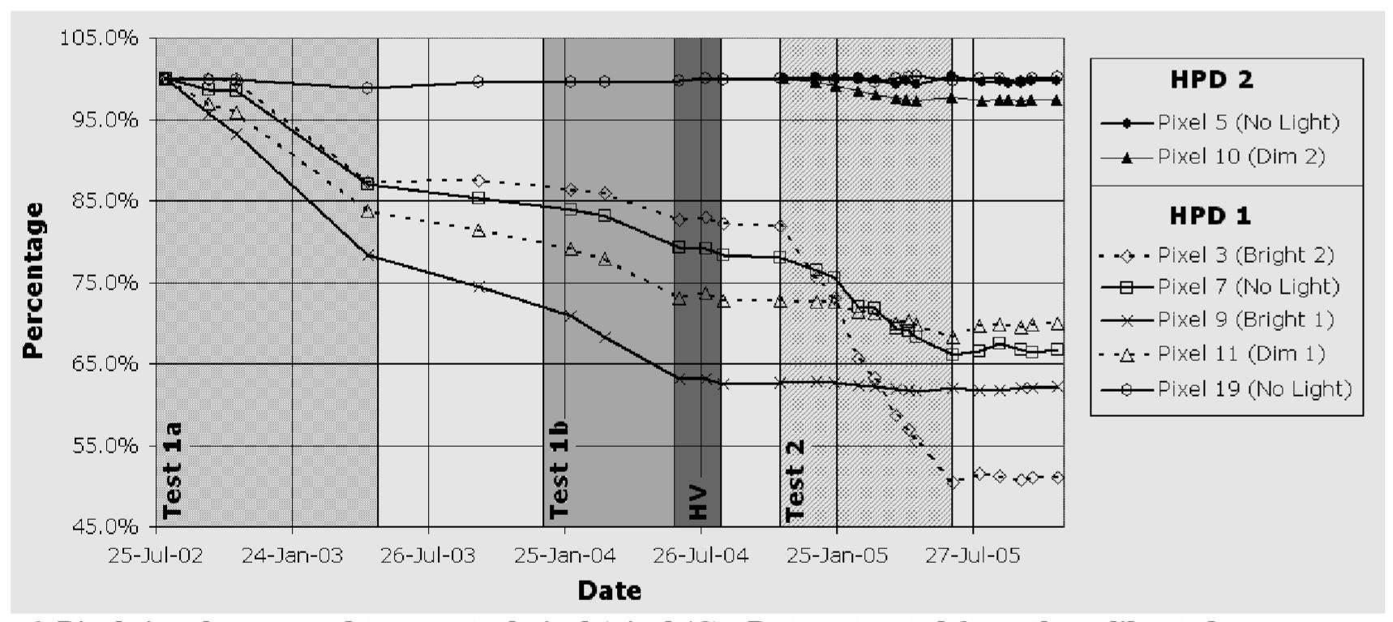
The in-situ data of the second test provides a more detailed and continuous time-dependent response curve.

Slide 17
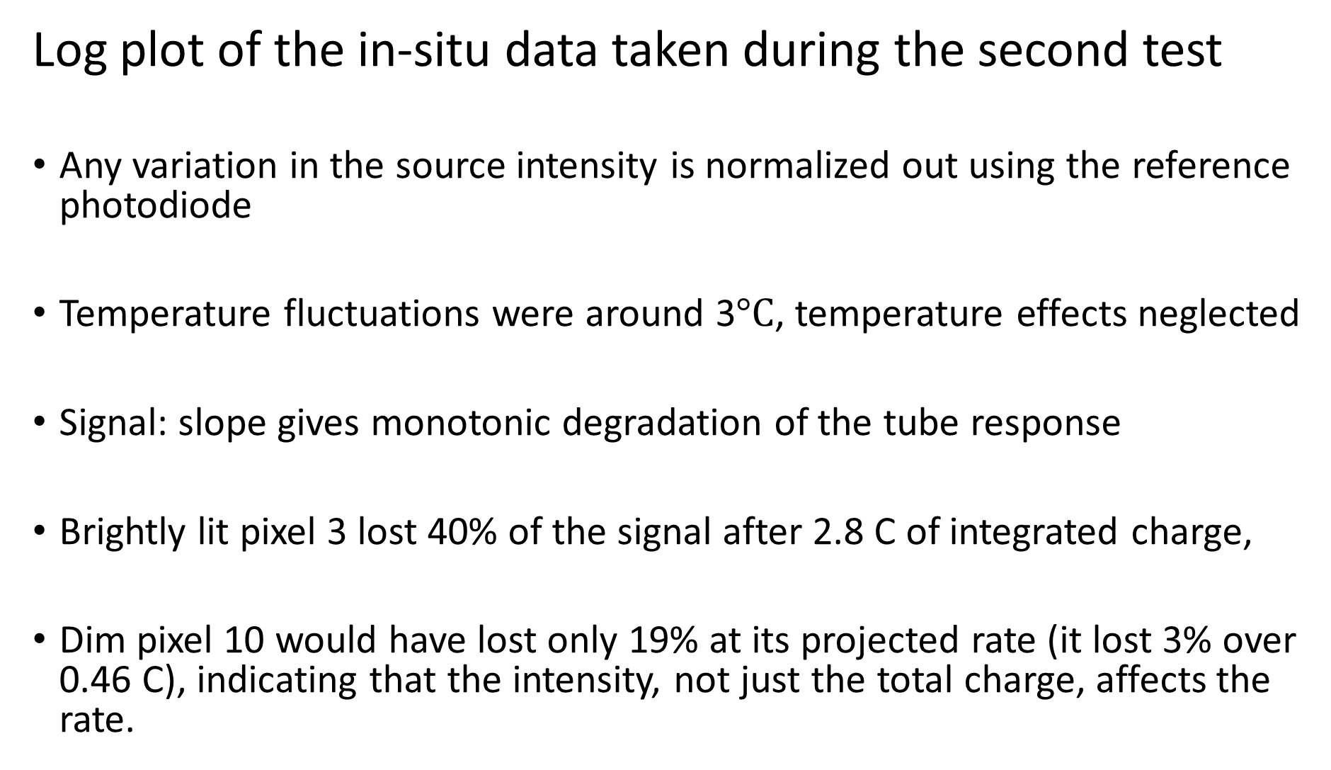
Log plot of the in-situ data taken during the second test
Any variation in the source intensity is normalized out using the reference photodiode
Temperature fluctuations were around 3$°C$, temperature effects neglected
Signal: slope gives monotonic degradation of the tube response
Brightly lit pixel 3 lost 40% of the signal after 2.8 C of integrated charge,
Dim pixel 10 would have lost only 19% at its projected rate (it lost 3% over 0.46 C), indicating that the intensity, not just the total charge, affects the rate.

Slide 18
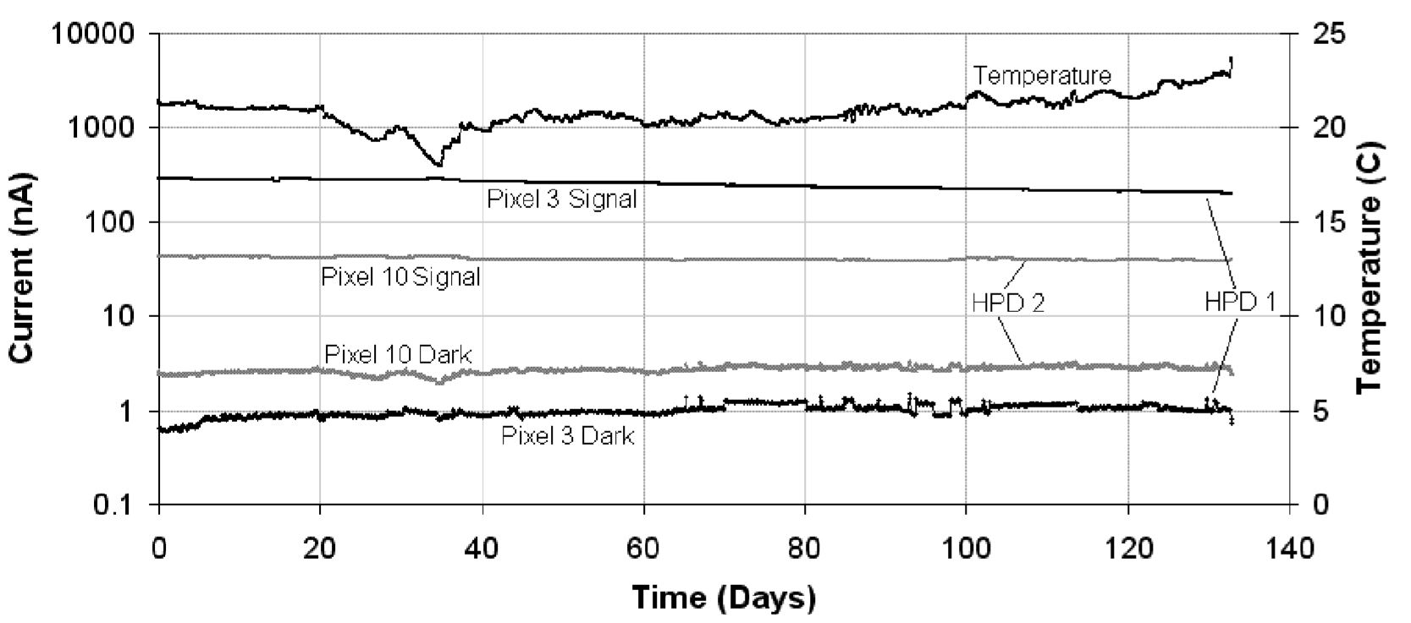
Temperature, pixel dark current, and light (signal-dark); recorded automatically every 2 hours.

Slide 19
High Voltage Aging tests
8 HPDs were operated at V_{gap} between 8-10 kV for 18 months to test the effect of high voltage alone
Four HPDs (B1, B2, B3, B4) - breakdown problems above V_{gap} > 10 kV
Four good HPDs (G1, G2, G3, G4)
Why?
To check if the “bad” HPD’s would have more problems just remaining at high voltage than the HPD’s that appeared normal
Periodically removed from the setup to undergo area scans, gain curve, and other measurements in our quality assurance stations

Slide 20
First set of rows: applies to all the tubes
AC Crosstalk:
Capacitively-coupled cross talk
DC Crosstalk:
optical Crosstalk
Bias Curve test:
is sensitive to the shape of the tube response curve as a function of reverse bias, essentially determining whether there was a change in the breakdown voltage of the diode itself.
HV Curve:
measures the linearity of the HV curve by forming a ratio of the slope from 8-12 KV to the slope from 6-8 kV. An upturn in the slope at higher voltages indicates possible low level sparking.

Slide 21
Viking test:
measures the resolution of the single photoelectron peaks at very low light levels.
It can detect the onset of ion feedback due to poor vacuum, but in these cases, it fails because the current out of at least one pixel is too high or fluctuating, thus loading the system preamp.
E/P stands for Electrons/Photons and is the number of Coulombs out the anode divided by the number of photons in the front. It is therefore the calibrated tube response. Once the gain is factored out, it gives the QE.

Slide 22
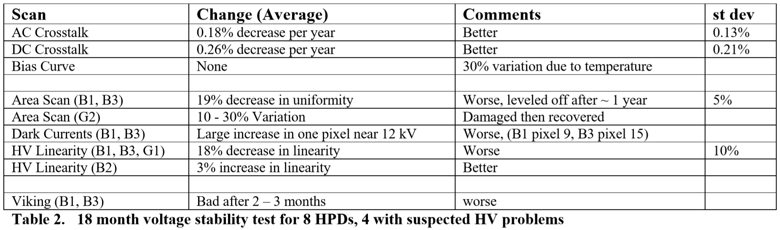

Slide 23
The gain of the tubes is a stable quantity over time.
The overall dark current decreased for most of the HPDs during the HV-only test, as did the optical crosstalk and capacitively-coupled crosstalk.
The QE can be affected by operation (even without light injection) if the tubes have HV instabilities.
For three of the HPD’s (B1, B3, G2), area scans show large changes in QE during the test, but all three appear to have been affected differently.

Slide 24
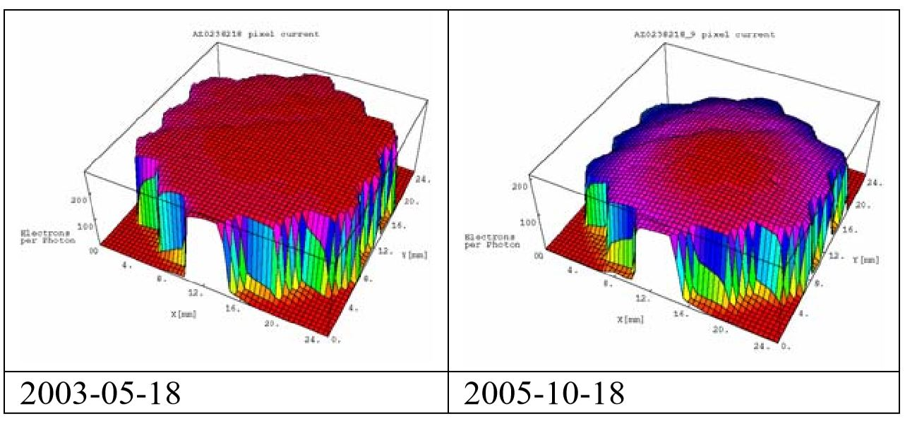
B1 and B3: Decreased QE, surface response became non-uniform
B1 area scans for selected times during HV-only test

Slide 25
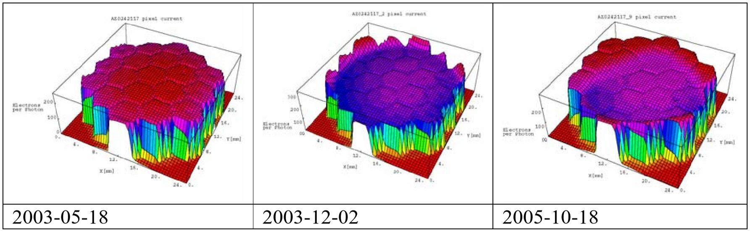
B3 area scans for selected times during HV-only test

Slide 26
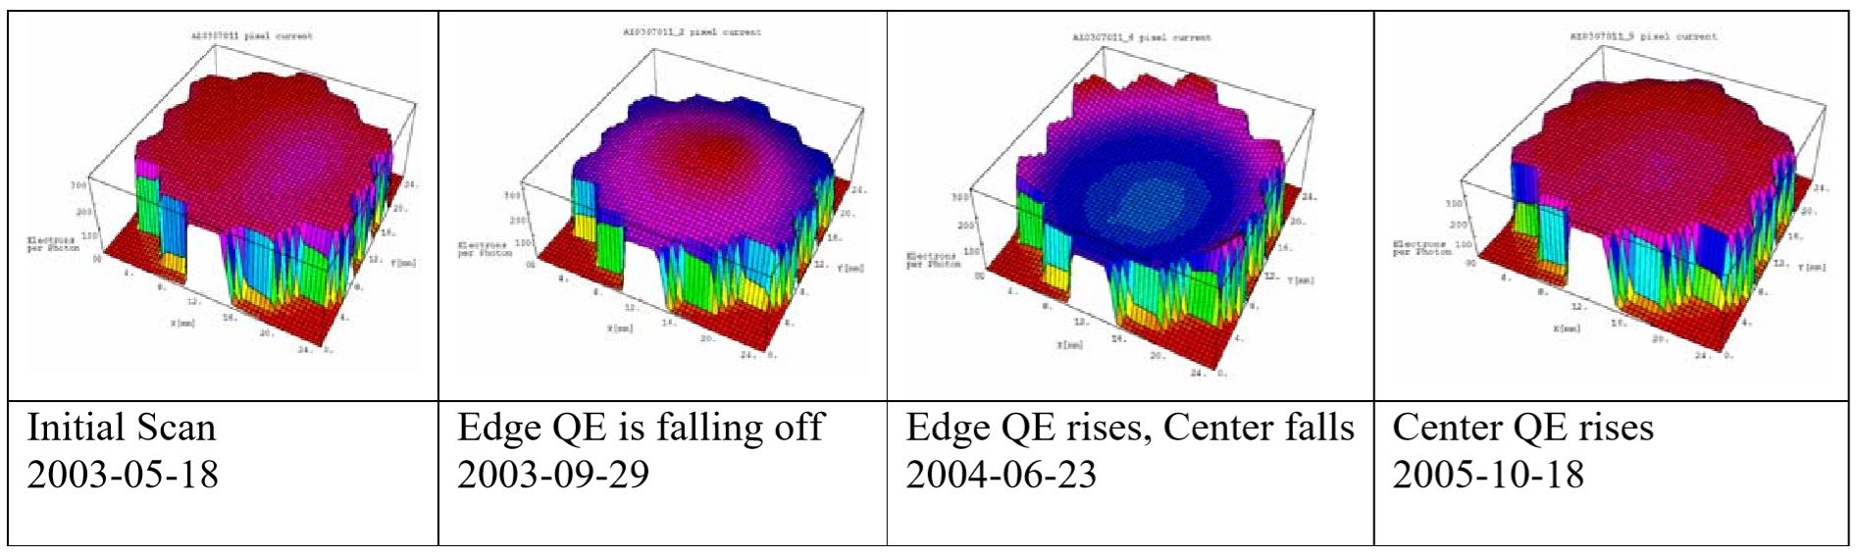
G2 actually redistributed its response over time
G2 area scans for selected times during HV-only test

Slide 27
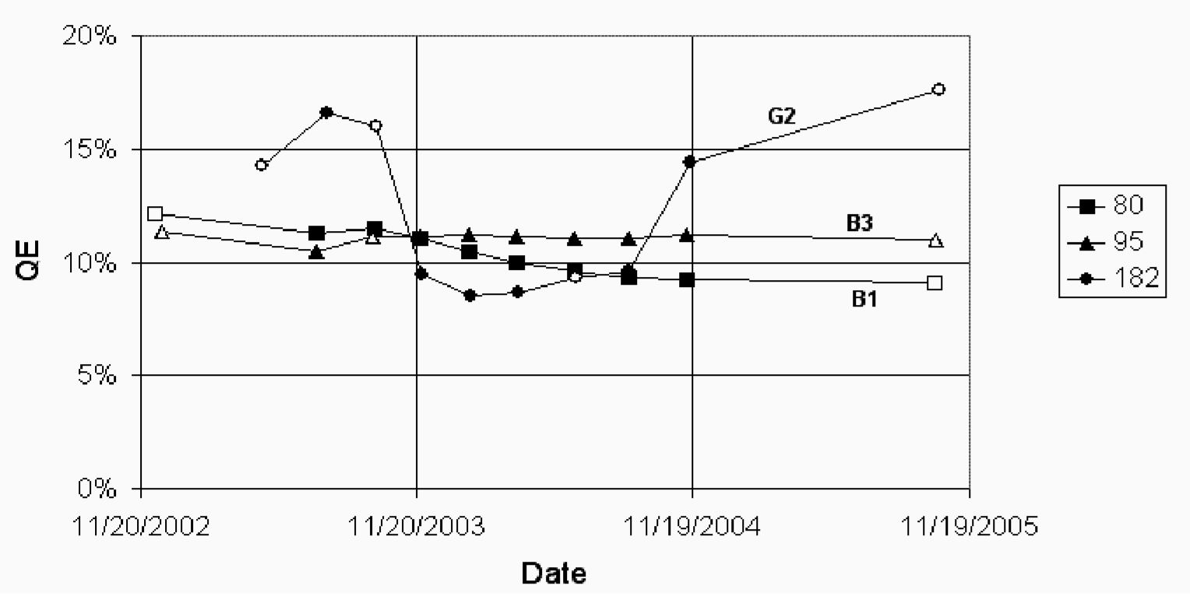
The area scans are calibrated and the QE of just the center pixel (pixel 10) is tracked, demonstrating that G2 actually lost QE on the edges, then gained QE back again (rather than becoming uniform at a lower QE). For the last few months of the test it was operating within CMS specification.
The QE of the center pixel as a function of time during the HV-only tests
The open circles correspond to the dates of the plotted area scans previous figures

Slide 28
The QE of the center pixel as a function of time during the HV-only tests
The open circles correspond to the dates of the plotted area scans previous figures

Slide 29
B1, B3 have V_{gap} dependent pixel leakage currents.
Connected to the observed non-linearities in the HV response curve.
The response above 10 kV would vary as much as 10% from measurement to measurement within that timescale.
HPDs having large variations in area scans are almost always accompanied by an upturn in the HV curve above 10 kV, indicating that the area scan non-uniformity is due to the onset of HV breakdown.
The converse is not true, however. Many HPDs with a non-linear slope above 10 kV have good area scans.
B2 was the only HPD with a non-linear HV at the start of the test, and it
appears to have healed during the 18 months on high voltage, such that it is
hardly noticeable in the scans taken at the end of the test.

Slide 30
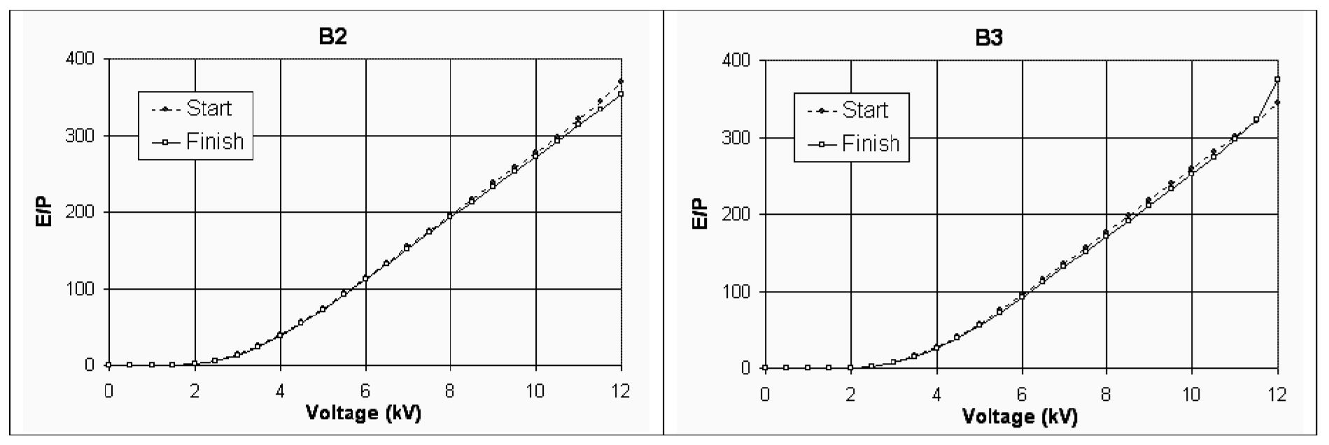
Linearity of HV response curve.
B2 (left) linearity improved with time
B3 (right) became worse.
This is related to HV instabilities the dark currents in some pixels becoming elevated when the tube is operated higher than 10 kV. Since this is an instability, the HV curve can fluctuate from day to day; the fact that it appears to be “cured” on the test date should not be trusted.

Slide 31
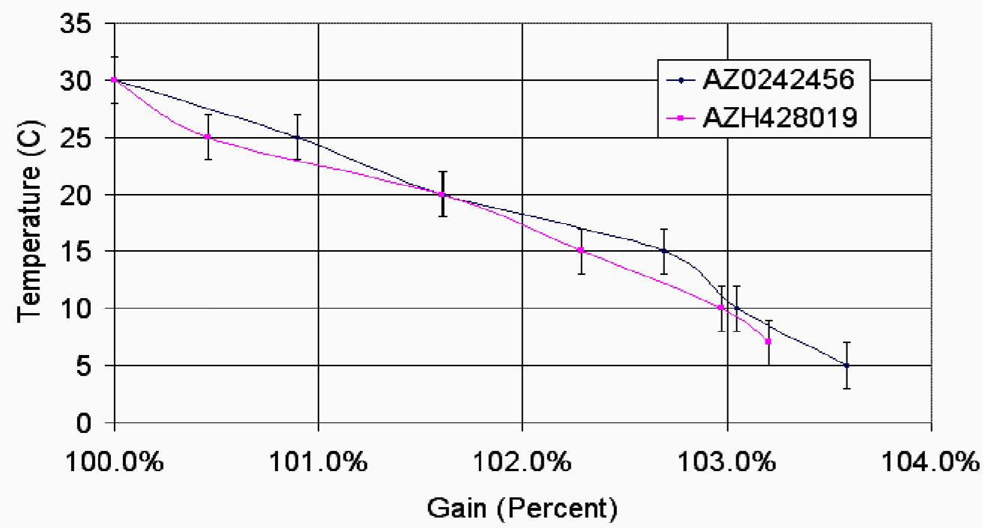

There was also a 20 – 25% decrease in the dark current of the HPDs over the winter. This is due to temperature fluctuations in the room, since the dark current changes by about 20% for a 10oC temperature shift. The gain, on the other hand, is less sensitive to temperature fluctuations, increasing by approximately 1.5 % over 10$°$C.

Slide 32
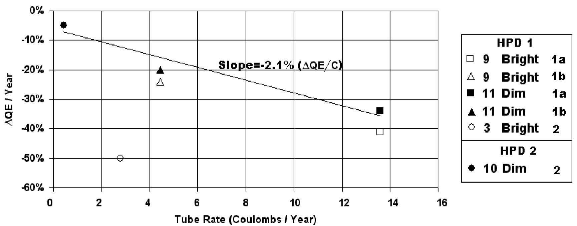
Conclusion
The damage covers an area of several pixels, thus forcing the dimmer pixel to be damaged at the rate determined by incident light into both itself and the close brighter pixel.
If plotted this way, the slope seems to remain the same for all rates of illumination. The quantum efficiency is reduced by about 2% every C through the anode.

Slide 33
For CMS tubes running at 0.3 C/yr over 10 years, one might expect a 6% reduction.
Pixel 3 of HPD-1 in the second test does not fall along this curve, experiencing a much steeper rate of damage. However, this is probably because it is an edge pixel in an already highly-damaged tube
The non-uniformity in QE caused by light injection does not appear to decrease during storage in a darkened environment.

